Slide 1
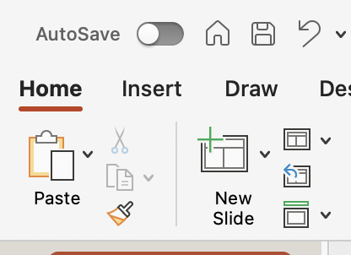
Slide Templates
Click the small down arrow next to New Slide to view the full range of templates.

